Slide 1

FPT University
Android programMing
Lesson 9
Version 1.0

Slide 2
Agenda
Implementing an Android Navigation Drawer
Master/Detail Flow

Slide 3
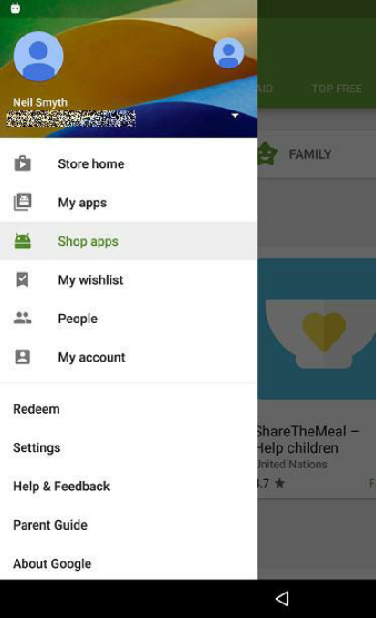
Implementing an Android Navigation Drawer
Overview of the Navigation Drawer The navigation drawer is a panel that slides out from the left of the screen and contains a range of options available for selection by the user

Slide 4
Implementing an Android Navigation Drawer
Navigation drawer is made up of the following components:
An instance of the DrawerLayout component.
An instance of the NavigationView component embedded as a child of the DrawerLayout.
A menu resource file containing the options to be displayed within the navigation drawer.
An optional layout resource file containing the content to appear in the header section of the navigation drawer.
A listener assigned to the NavigationView
An ActionBarDrawerToggle instance to connect and synchronize the navigation drawer to the app bar.

Slide 5
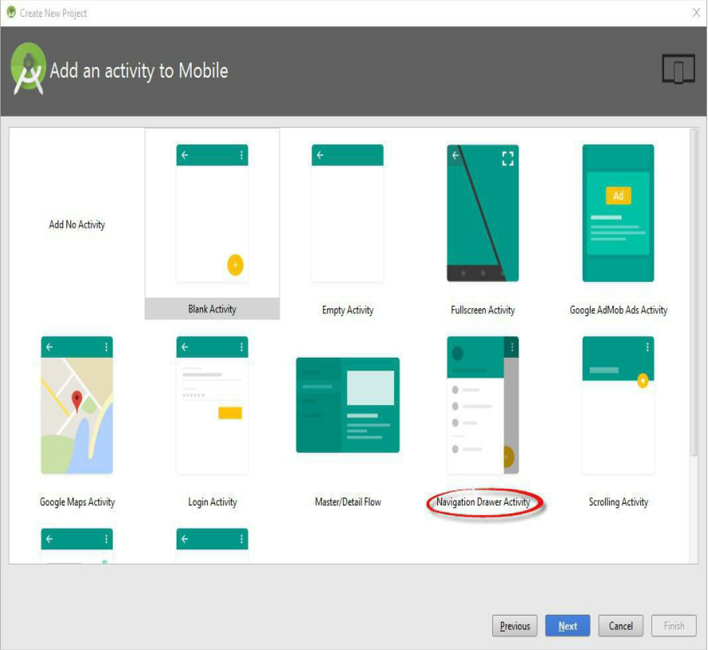
Implementing an Android Navigation Drawer
Using the Navigation Drawer Activity Template

Slide 6
Implementing an Android Navigation Drawer
The Template Layout Resource Files
activity_nav_drawer.xml
app_bar_nav_drawer.xml
content_nav_drawer.xml
nav_header_nav_drawer.xml
Notes:
activity_nav_drawer.xml – This is the top level layout resource file. It contains the DrawerLayout container and the NavigationView child. The NavigationView declaration in this file indicates that the layout for the drawer header is contained within the nav_header_nav_drawer.xml file and that the menu options for the drawer are located in the activity_nav_drawer_drawer.xml file. In addition, it includes a reference to the app_bar_nav_drawer.xml file. · app_bar_nav_drawer.xml – This layout resource file is included by the activity_nav_drawer.xml file and is the standard app bar layout file built within a CoordinatorLayout container as covered in the preceding chapters. As with previous examples this file also contains a directive to include the content file which, in this case, is named content_nav_drawer.xml. · content_nav_drawer.xml – The standard layout for the content area of the activity layout. This layout consists of a ConstraintLayout container and a “Hello World!” TextView. · nav_header_nav_drawer.xml – Referenced by the NavigationView element in the activity_nav_drawer.xml file this is a placeholder header layout for the drawer.

Slide 7
Implementing an Android Navigation Drawer
Modification of Navigation Drawer

Slide 8
Master/Detail Flow
The Master/Detail Flow A master/detail flow is an interface design concept whereby a list of items (master list) is displayed to the user. On selecting an item from the list, additional information relating to that item is then presented to the user within a detail pane

Slide 9
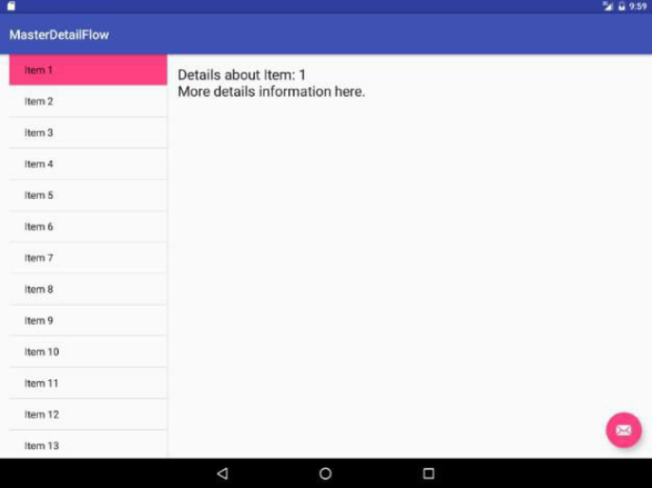
Master/Detail Flow
Example of Master/Detail Flow

Slide 10
Master/Detail Flow
On smaller, phone sized Android devices, the master list takes up the entire screen and the detail pane appears on a separate screen which appears when a selection is made from the master list. In thismode, the detail screen includes an action bar entry to return to the master list

Slide 11
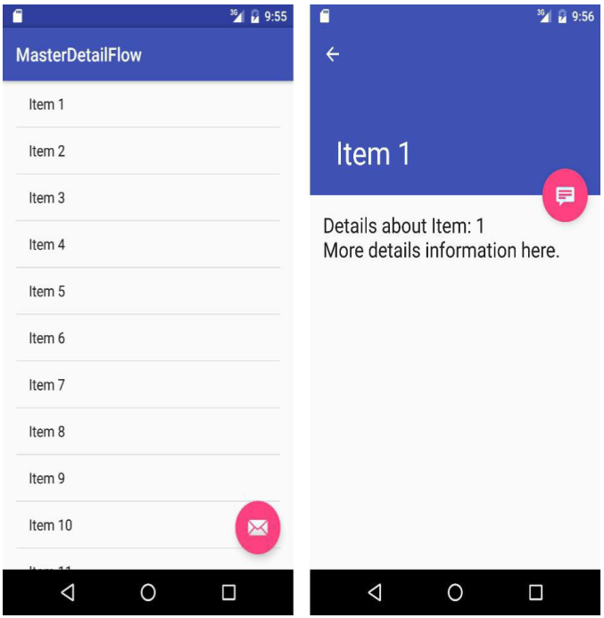
Master/Detail Flow
Master/Detail Flow in small device

Slide 12
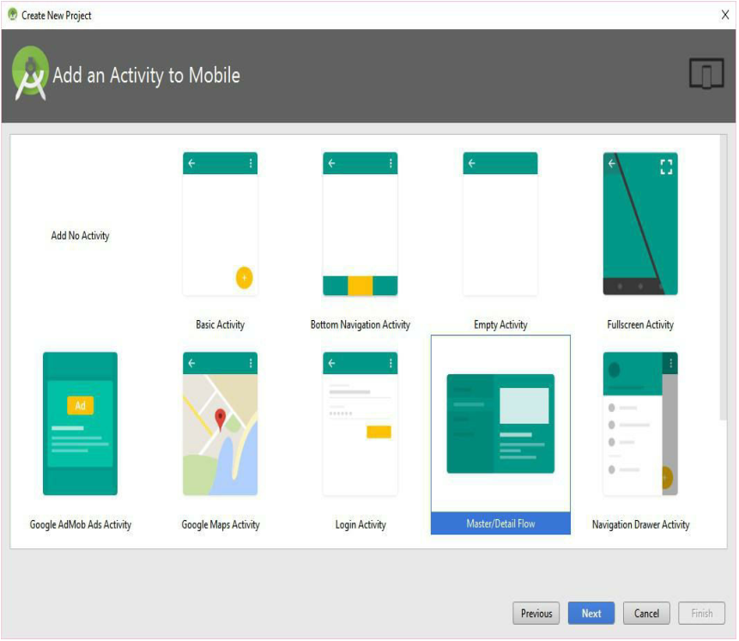
Master/Detail Flow
Creating a Master/Detail Flow Activity

Slide 13
Master/Detail Flow
The Anatomy of the Master/Detail Flow Template When an activity Master/Detail Flow template is created, a number of Java andXML layout resource files will have been created automatically

Slide 14
Master/Detail Flow
activity_<item>_list.xml
<item>ListActivity.java
<item>_list.xml
<item>_list.xml (w900dp)
<item>_content_list.xml
activity_<item>_detail.xml
<item>DetailActivity.java
<item>_detail.xml
<item>DetailFragment.java
DummyContent.java

Slide 15
Master/Detail Flow
Modifying the Master/Detail Flow Template
Changing the Content Model
Changing the Detail Pane

Slide 16
Master/Detail Flow
Changing the Content Model
public static class DummyItem { public final String id; public final String website_name; public final String website_url; public DummyItem(String id, String website_name, String website_url) { this.id = id; this.website_name = website_name; this.website_url = website_url; } @Override public String toString() { return website_name; } }

Slide 17
Master/Detail Flow
Adding data
static { // Add 3 sample items. addItem(new DummyItem("1", "Google", "http://www.goolge.com")); addItem(new DummyItem("2", "Amazon", "http://www.amazon.com")); addItem(new DummyItem("3", "New York Times", "http://www.nytimes.com")); }

Slide 18
Master/Detail Flow
Changing the Detail Pane
Change TextView to WebView
<?xml version="1.0" encoding="utf-8"?> <WebView xmlns:android="http://schemas.android.com/apk/res/android" xmlns:tools="http://schemas.android.com/tools" android:layout_width="match_parent" android:layout_height="match_parent" android:id="@+id/website_detail" tools:context="com.example.<Package Name>.WebsiteDetailFragment"> </WebView>

Slide 19
Master/Detail Flow
Loading web content
@Override public View onCreateView(LayoutInflater inflater, ViewGroup container, Bundle savedInstanceState) { View rootView = inflater.inflate(R.layout.website_detail, container, false); // Show the dummy website_name as text in a TextView. if (mItem != null) { ((WebView) rootView.findViewById(R.id.website_detail)) .loadUrl(mItem.website_url); WebView webView = (WebView) rootView.findViewById(R.id.website_detail); webView.setWebViewClient(new WebViewClient(){ @Override public boolean shouldOverrideUrlLoading( WebView view, WebResourceRequest request) { return super.shouldOverrideUrlLoading(view, request); } }); webView.getSettings().setJavaScriptEnabled(true); webView.loadUrl(mItem.website_url); } return rootView; }

Slide 20
Master/Detail Flow
Add permission
<?xml version="1.0" encoding="utf-8"?> <manifest xmlns:android="http://schemas.android.com/apk/res/android" package="com.example.thaigiang.testingfromchapter33"> <uses-permission android:name="android.permission.INTERNET" /> <application android:allowBackup="true" android:icon="@mipmap/ic_launcher" android:label="@string/app_name" android:roundIcon="@mipmap/ic_launcher_round"

Slide 21
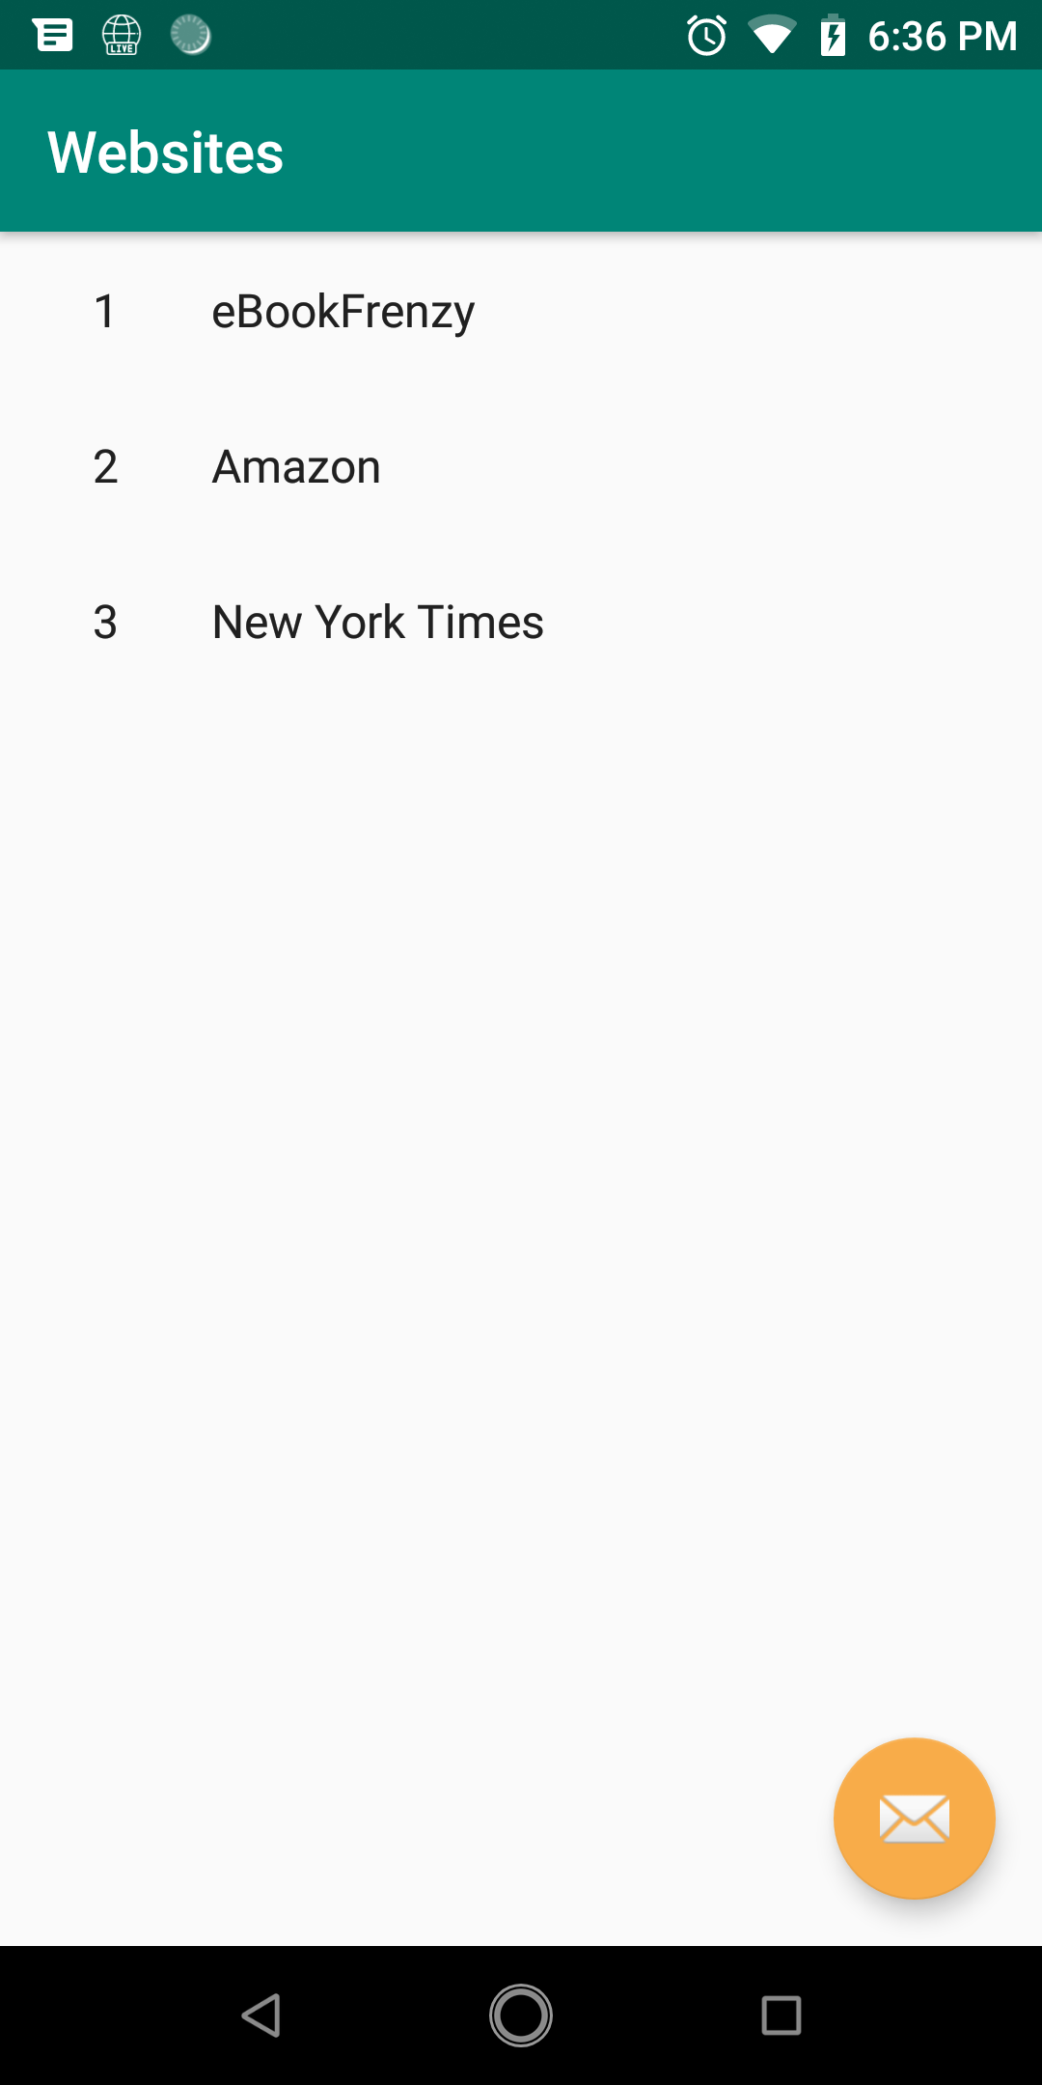
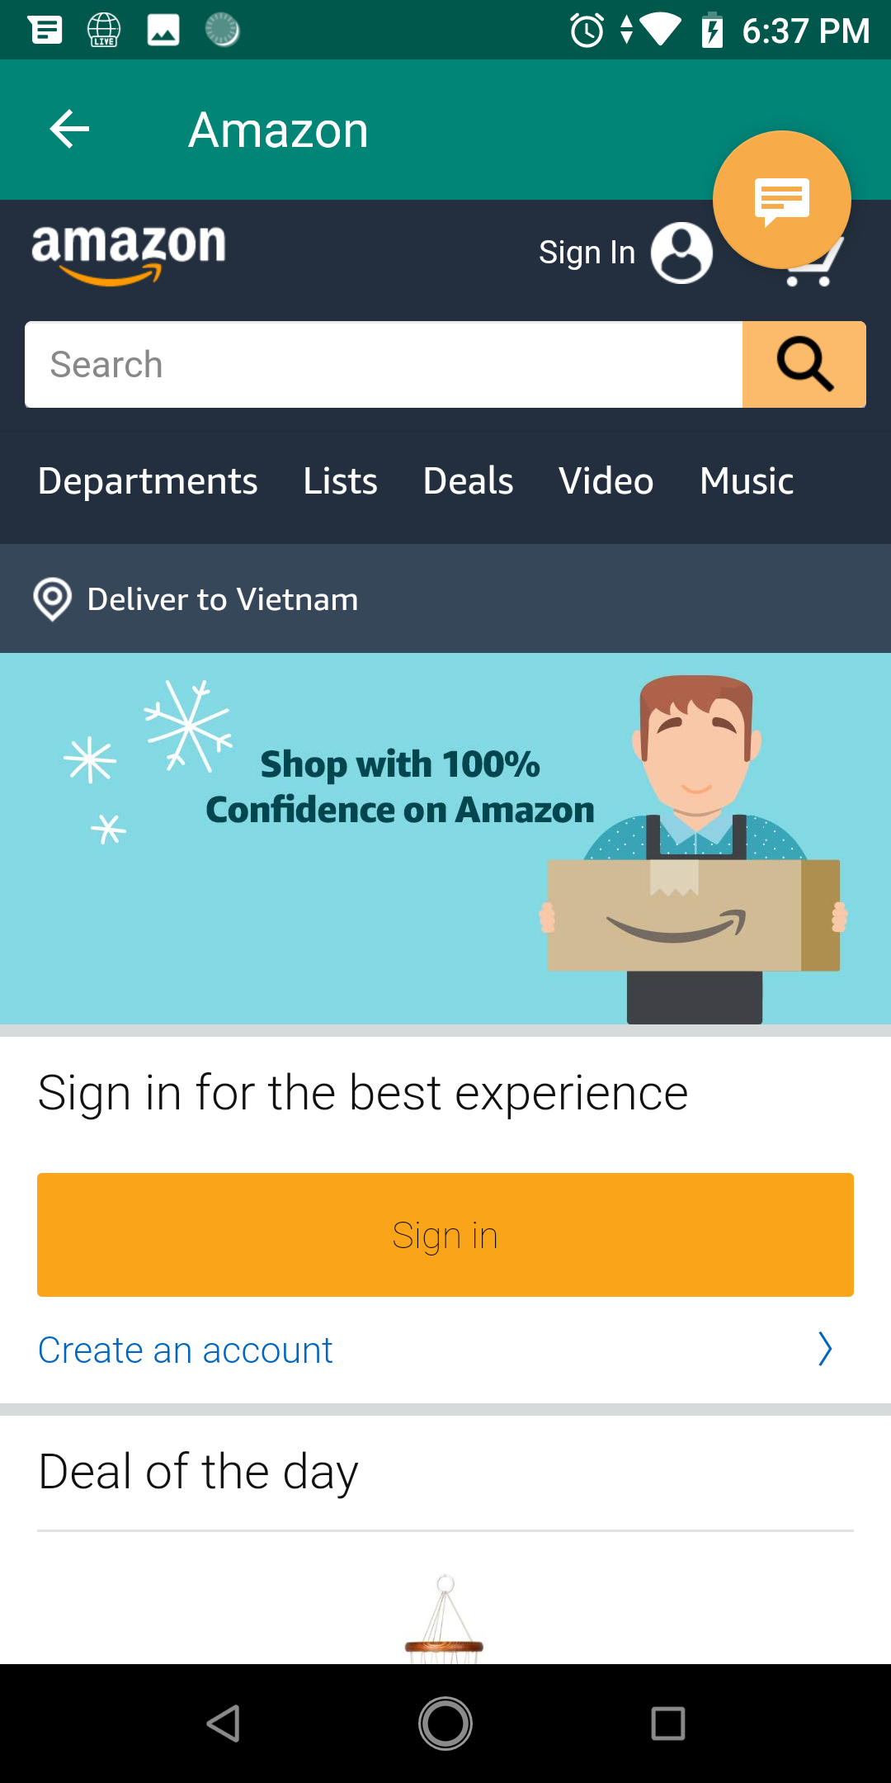
Master/Detail Flow
Testing application

Slide 22

End of Lesson 9

Slide 23
Thank you!

